Slide 1

PeopleSoft Segregation of Duties
Spearmc’s SOD Analyzer solution

Slide 2

Your Presenter
RANDALL JOHNSON
Vice President
randall.johnson@spearmc.com
(847) 507-7647

Slide 3
Products and Services
HEALTHCARE | HIGHER ED | FINANCIAL SERVICES | PUBLIC SECTOR
Managed Services
Consulting Services
PeopleSoft Training
Application Support
Testing as a Service
System Administration
Decustomization
Financials and Grants Mgmt
Supply Chain Mgmt
Human Capital Management
Campus Solutions
All Access Learning Pass
Live Private Training
Oracle Guided Learning
Oracle University Reseller
Oracle PeopleSoft
Oracle Cloud Platform
Emerging Technology
Proprietary Products
OCI Migration
Infrastructure Hosting
Disaster Recovery
Kibana Data Analytics
Chatbots and Digital Assistants
Cloud Assessments
PTF Testing Grounds
Grants: LCD/Effort Reporting
Supplier Contracts: Authoring
Lease Admin: GASB 87

Slide 4
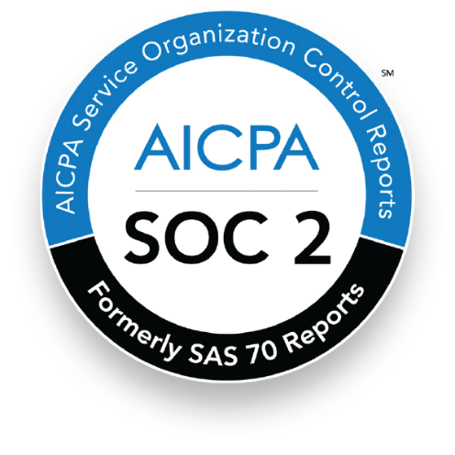

Recognition and Specializations
SOC 2 Type II Certified
As a SOC 2 Type II Certified provider, SpearMC completes an annual assessment and undergoes regular independent auditing and security testing to ensure we are adhering to the latest SSAE 18 standard. This certification demonstrates our deep commitment to protecting data. It covers everything from how we secure our customers’ information to how we verify the identities and backgrounds of our employees.
Gartner-Recognized Vendor for OCI Professional
and Managed Services
SpearMC is the only PeopleSoft partner recognized in Gartner’s 2021 and 2022 Market Guide for Oracle Cloud Infrastructure Professional and Managed Services. Our team utilizes integrated technical and functional roadmaps, fully leverages Oracle Cloud Platform tools and offers functional expertise to maximize OCI during migrations. Our OCI capabilities facilitate an agile approach to supporting demonstrations and discussions.

Slide 5
Segregation of Duties as Key Control
Systematic Segregation of Duties = “Key Internal Control”
PeopleSoft Security Structure
  Page Level Access
    Process Rights:
      Add
      Update
      Update / Display
      Correct History
      Display Only
  Permission Lists
    Series of Application Pages Combined
    Logical Grouping Based on Business Process Requirements
  Roles
    Combined Permission Lists
    Generally defined by Business Process
  User Profiles
    Roles assigned to Individual System Users

Slide 6
How SOD Conflicts are Introduced
Permission List Maintenance
  New Pages Introduced
  Neglect to flag ‘Display Only’
  User Requests
Role Maintenance
  User’s Job Duties Change
    New Roles Added
    Prior Roles Remain Active
New System Users
  Mergers / Acquisitions
  Expanded System Profile

Slide 7
SOD Analyzer Overview
Page To Page Rule Sets
Over 500 Pre-Built Rules
Flexible and Configurable Rule Maintenance Setup
Cross Platform SOD Analysis with Unified Navigation
PeopleSoft Insights (Kibana Dashboards) With Detailed Analytics

Slide 8
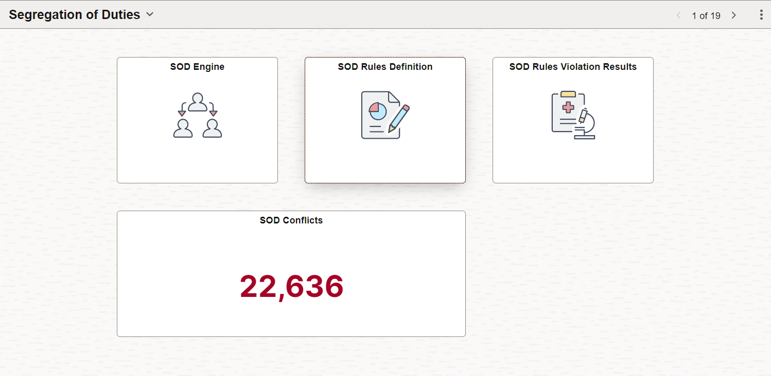
SOD Rules Definition

Slide 9
SOD Rule Definition

Slide 10
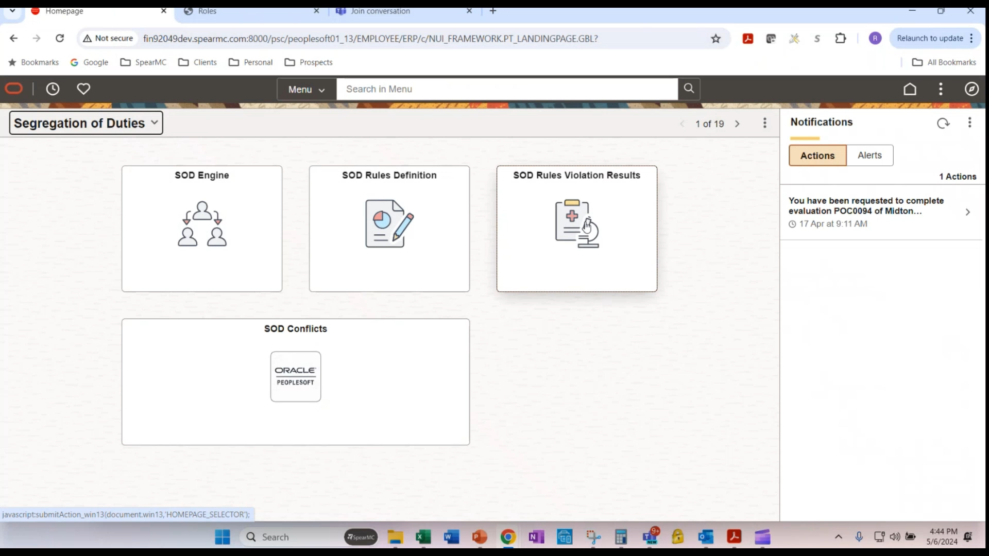
SOD Rule Definition

Slide 11
SOD Rule Definition

Slide 12
SOD Rules Definition

Slide 13
SOD Rules Violation Results

Slide 14
SOD Rules Violation Results

Slide 15
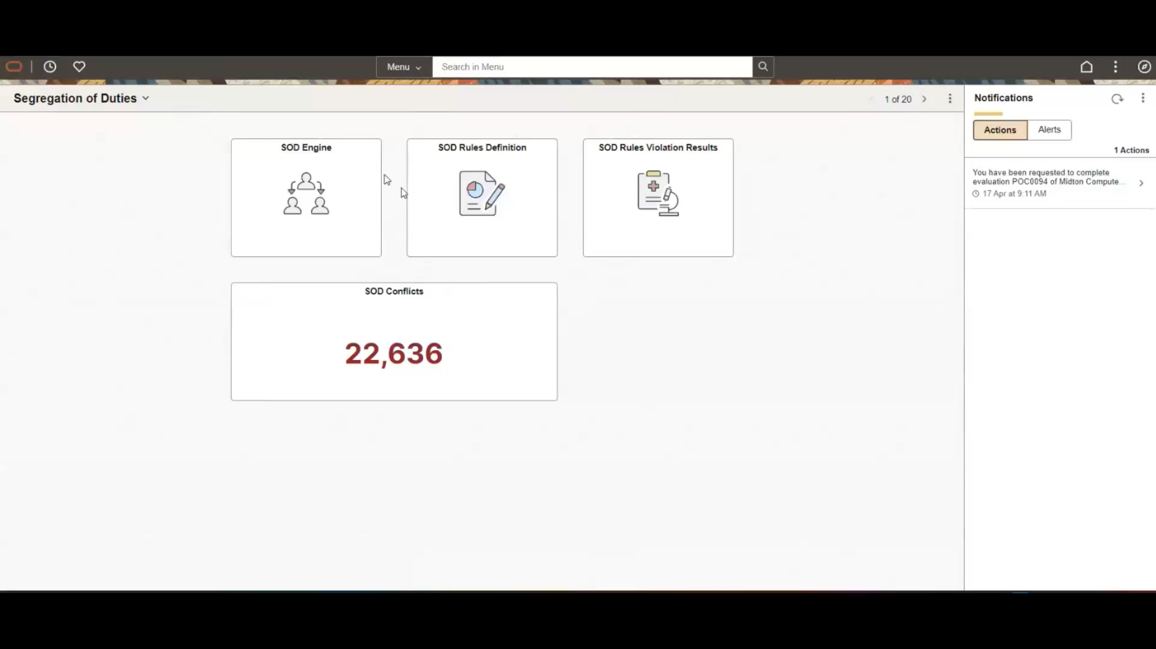
SOD Rules Violation Results

Slide 16
SOD Rules Violation Results

Slide 17
PeopleSoft Insights Analytics for the SOD Analyzer

Slide 18
PeopleSoft Insights Analytics for the SOD Analyzer

Slide 19
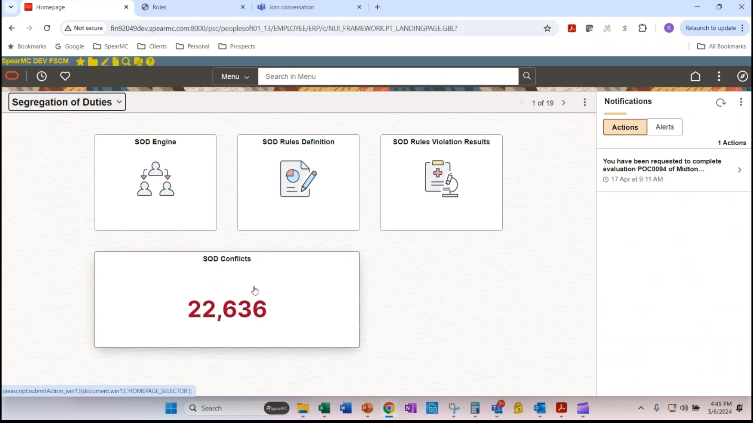
PeopleSoft Insights Analytics for the SOD Analyzer

Slide 20
PeopleSoft Insights Analytics for the SOD Analyzer

Slide 21
PeopleSoft Insights Analytics for the SOD Analyzer

Slide 22
What’s Next? Planned Features and Enhancements
Expand length of SOD Rule Description field
Insert additional long description field
Enhance reporting for active SOD rule listing
Develop ‘mitigating control’ functionality
Enhancements to PeopleSoft Insights (need customer feedback)
New module called “SOD Preventer”

Slide 23
Questions?
Randall Johnson, Vice President – randall.johnson@spearmc.com
847-507-7647

